Slide 1
SOFTWARE DEVELOPMENT 3
Data & Formatting

Slide 2
Formatting Output with printf
Java includes a method named printf that can be used to produce output in a specific format
The Java method printf is similar to the print method
  Like print, printf does not advance the output to the next line
System.out.printf can have any number of arguments
  The first argument is always a format string that contains one or more format specifiers for the remaining arguments
  All the arguments except the first are values to be output to the screen

Slide 3
printf Format Specifier
The code
  double price = 19.8;
  System.out.print(“€");
  System.out.printf("%5.2f", price);
  System.out.println(" each");
will output the line
  €19.80 each
The format string "%5.2f" indicates the following:
  start the format specifier (%)
  field width is 5
  Display exactly 2 digits after the decimal point (.2)
  Display a floating point number, and end the format specifier (i.e., the conversion character is f)

Slide 4
Multiple arguments with printf
The following code contains a printf statement with three arguments
  The code
    double price = 19.8;
    String name = "magic potion";
    System.out.printf(“€%5.2f for each %s.",price, name);
    System.out.println();
  will output
    €19.80 for each magic potion.
  Note that the first argument is a format string containing two format specifiers (%5.2f and %s)
  These format specifiers match up with the two arguments that follow (price and name)

Slide 5
Line Breaks with printf
Line breaks can be included in a format string using %n
The code
    double price = 19.8;
    String name = "magic potion";
    System.out.printf(“€%5.2f for each %n%s", price, name);
    will output
    €19.80 for each
    magic potion
See TestFormat1.java

Slide 6

Formatting Money Amounts with printf
A good format specifier for outputting an amount of money stored as a double type is %.2f
It says to include exactly two digits after the decimal point and to use the smallest field width that the value will fit into:
  produces the output:

Slide 7
String class format( ) method:
You can build a formatted String and assign it to a variable using the static format method in the String class.
The use of a format string and argument list is identical to its use in the printf method.
The format method returns a reference to a String. Example:
  produces the output:

Slide 8
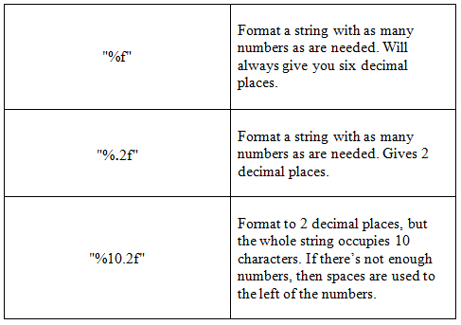
Formatting Symbols
Floating Point Formatting

Slide 9
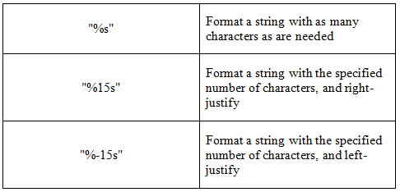
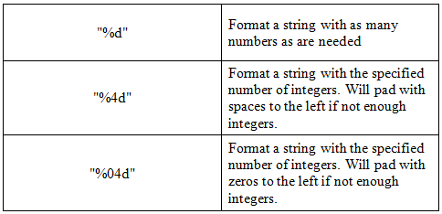
Formatting Symbols
String Formatting Integer Formatting
See sample program TestFormat2.java

Slide 10
NumberFormat Class
NumberFormat is the abstract base class for all number formats
Use getCurrencyInstance to get the currency number format
Use the format() method with the number to format the number according to the currency of the default locale

Slide 11
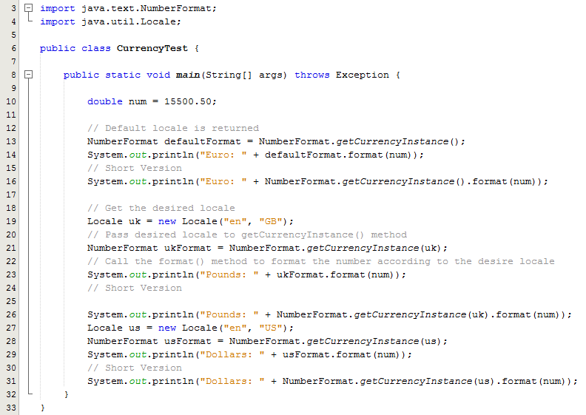
Example – CurrencyTest.java
Note the use of the two packages
Sample Output:
Euro: €15,500.50
Euro: €15,500.50
Pounds: £15,500.50
Pounds: £15,500.50
Dollars: $15,500.50
Dollars: $15,500.50

